Slide 1
2020 Community development block grant Corona virus (CDBG-CV)
Presented By: Maumee Valley Planning Organization
Serving: Fulton county | henry County | Paulding county | defiance county | Williams County
Notes:
Thank you for coming this evening. We are happy you are here.

Slide 2
Welcome
Dennis Miller, MVPO Executive Director
Christina Deehr, MVPO Community Development Planner
Agenda:
MVPO Role and Mission Overview
Q & A Session
Next steps
Eligible Public Services & Costs
National Objectives
Eligible Public Facilities & Costs
Eligible Communities : LMI Data
Examples
Introduction to the Community Development Block Grant- Corona Virus (CDBG-CV) Funding
Due to COVID-19 threats, this public forum is only being held virtually. If you are unable to access this virtual forum, you can visit MVPO’s website for a recording of this presentation or call MVPO to schedule a very small, in-person presentation appointment.
Phone: 419-784-3882 | Website: WWW.MVPO.ORG
VIRTUAL PRESENTATIONS
Thursday, October 22, 2020
9:00 AM & 12:00 PM
Monday, October 26, 2020
6:00 PM
Zoom Meeting Link: https://zoom.us/k/7594628169
Notes:
Introductions
Purpose for this evening

Slide 3
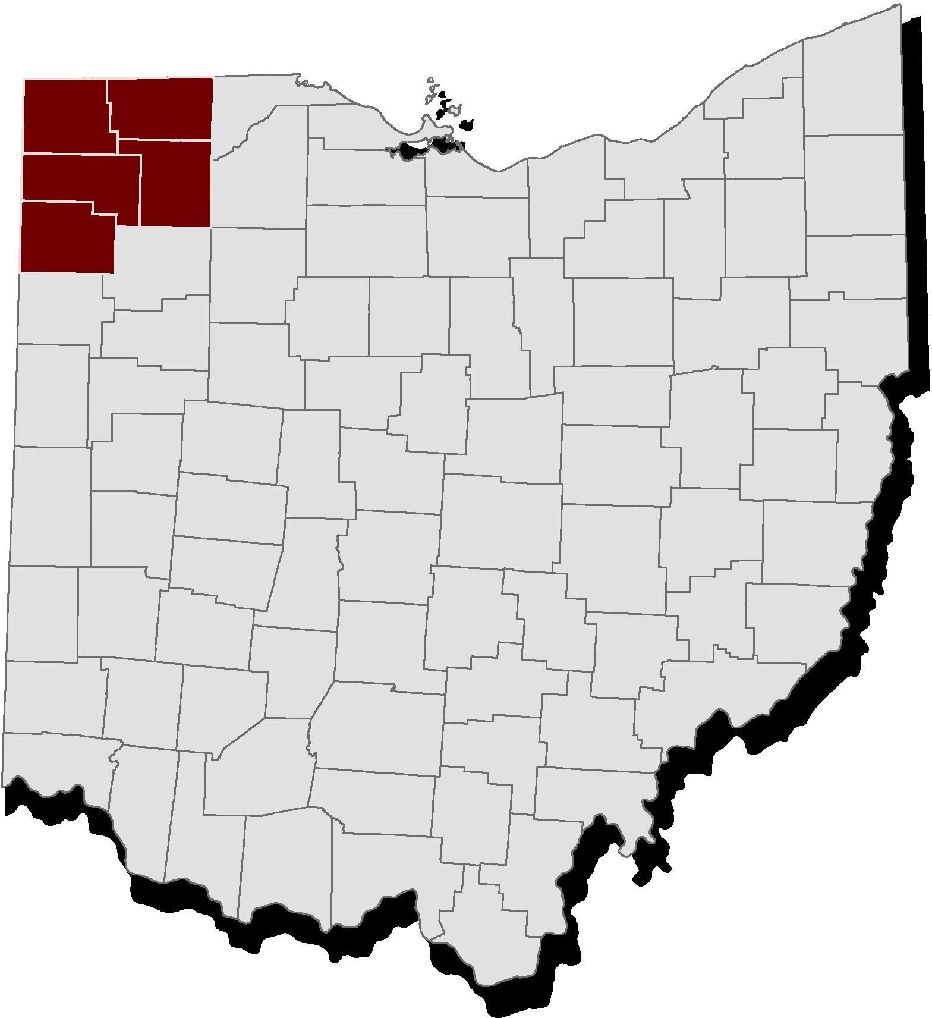
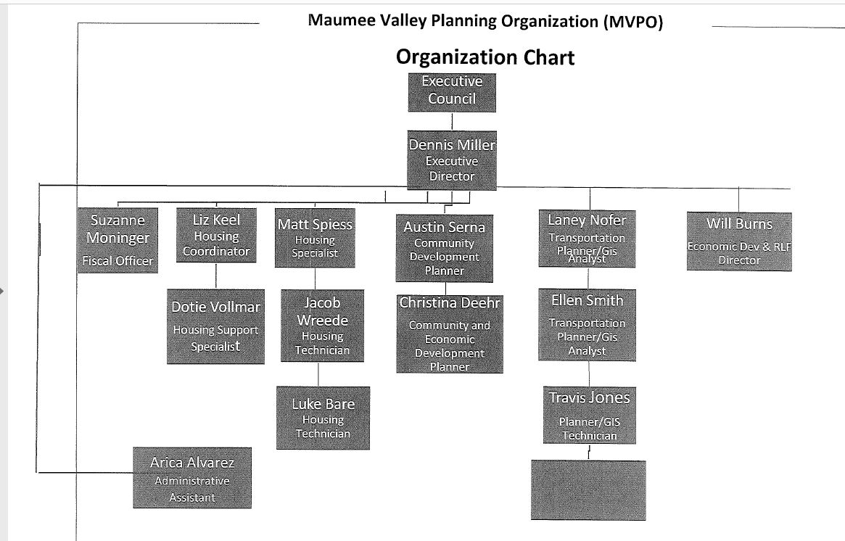
MVPO
Nonprofit organization serving a five-county region
MVPO’s mission is to assist planning efforts in community and economic development, provide a regional forum for sharing information and ideas, and promote cooperative solutions to regional issues
Notes:
Some of you may already know about our organization and some may not know everything we do. We are a non-profit organization that serves the five county area of Defiance, Fulton, Henry, Paulding, and Williams counties. Our mission is to plan for your future endeavors relating to economic development, housing improvements for low-and moderate income residents, regional zoning and planning, water & sewer, flood & drainage, parks and recreation, street & sidewalk improvements, demolitions, and ADA compliance.
Go through the Organizational Chart

Slide 4
CDBG-CV Funding Fast Facts.
Community Development Block Grant- Corona Virus (CDBG-CV)
Counties are the grantee.
Non-profit/Public Services organization are the subrecipient.
No match required
COVID-19 impacts
New or quantifiable increase in level of service
No min. or max. in funding request
$24 million in the state of Ohio
Accepting Pre-applications

Slide 5
Public services
Eligible Services
Eligible Costs
Child Care
Down Payment Assistance
Education
Energy Conservation Counseling & Testing
Health Care
Senior Services
Job Training
Services for Victims of Domestic Violence
Drug Abuse Counseling & Treatment
Emergency Assistance Payments
Fair Housing
Recreation
Transportation
Legal Services
Labor, defined as salaries and benefits for staff and contract employees;
Equipment, supplies, and materials, purchased or leased;
Facility operation and maintenance costs, limited to the portion of a facility in which an eligible public service is housed*

Slide 6
Public Service Example
Grantee uses CDBG funds for staff salaries and benefits, and operations at the county homeless shelter. The project is qualified under the Limited Clientele national objective; the project benefits Homeless Persons, a presumed class.
Grantee uses CDBG funds for Emergency Monthly Housing Payments for rent or mortgage, and utility costs on behalf of LMI households. The payments are made directly to the vendors and for no more than three consecutive months. This project is qualified under the Limited Clientele national objective; recipients must be income qualified.
Grantee uses CDBG funds to purchase a Meals on Wheels delivery van serving elderly and disabled adults. The project is qualified under the Limited Clientele national objective; the project benefits Elderly Persons and Severely Disabled Adults, presumed classes.

Slide 7
Public facilities
Facilities that are either publicly owned or traditionally provided by the government, or owned by a nonprofit, and operated as open to the general public.
Eligible Facilities
Ineligible Facilities
Day Care Centers
Domestic Violence Shelters
Homeless Shelters
Libraries
Public Schools
Police Stations
Disaster Shelters
Fire Stations
Hospitals
Nursing Homes
Senior Centers
Facilities for General Conduct of Government or Political Operations
Equipment, furnishings, or other personal property
Public housing construction

Slide 8
Public facilities Example
An Elementary School receives funding to install a new HVAC system that filter air. This keeps the air clean and minimizes the spread of COVID-19 from one classroom to another via the HVAC system.
Grantee uses CDBG funds to install a boiler system and HVAC upgrades at a county senior center. The project is qualified under the Limited Clientele national objective; the project benefits Elderly Persons, a presumed class.
Grantee uses funds to construct interior walls at the county health care center creating additional patient examination rooms. This project is qualified under the Area Benefit national objective; the city is more than 51% LMI and most beneficiaries are city residents.

Slide 9
National Objectives
Public Service activities are required to meet a national objective of low- and moderate-income (LMI) benefit.
Limited Clientele (LMC): The public service benefits a specific group of people that
meet one or more of the limited clientele presumed classes,
can be presumed LMI by the nature and location of the service provided, or
are income qualified as LMI. Limited Clientele projects do not require a geographic service area.
Area Benefit (LMA): The public service benefits all residents of a geographic service area. The service area must be primarily residential and at least 51% LMI as qualified by the American Community Survey or an income survey.
Public Service activities are required to meet a national objective of low- and moderate-income (LMI) benefit.
Limited Clientele (LMC):Same as described above.
Area Benefit (LMA): Same as described above.
Slum/Blight (S/B)
Spot Slum/Blight (SBS): The public facility is located outside a designated blighted area. Project activities are limited to addressing health and safety concerns.
Spot Slum/Blight (SBS): The public facility is located outside a designated blighted area. Project activities are limited to addressing health and safety concerns.

Slide 10
Area Benefit(LMA) Eligible Communities
Henry Co.
Paulding Co.
Fulton Co.
Defiance Co.
Williams Co.
McClure Village 53%
Village of Deshler (Income Survey Eligible)
Broughton Village 57%
Cecil Village 67%
Haviland Village 58%
Oakwood Village 59%
Paulding Township 51%
Paulding Village 53%
No eligible communities based on ACS data.
Fayette does have an eligible income survey on file.
Hicksville Village 56%
Sherwood Village 56%
Alcordton CDP 53%
City of Bryan 59%
Village of Edon 55%
Kunkle CDP 57.69%
Madison Township 54%
Village of Pioneer 53%
Pulaski CDP 57%
Village of West Unity 51%
All LMI data was retrieved for ODSA’s technical website, found here and is based on the ACS 2011-2015 results: https://development.force.com/OCDTA/s/article/ACS-2011-2015-Low-and-Moderate-Income-Summary-Data.
In some cases, an income survey can be conducted for some communities if the community is not included on the list above. Also, some projects make allow for individuals to be income qualified to receive the benefits provided by this grant opportunity.
Notes:
LMI: 51% can apply. LMI: under 51% and above 41% conduct income survey. LMI under 41% contact MVPO

Slide 11
LIMITED CLIENTELE
Battered Spouses
Homeless Persons
Migrant Farm Workers
Severely Disable Adults
Income Qualified as LMI
Elderly Adults
Illiterate Adults
Persons Living with Aids
Presume LMI by Nature/Location of Services

Slide 12
Questions?
Notes:
Now is the time to conduct income surveys. If your community does not have a completed income survey, MVPO will not be able to submit a project on your behalf.

